Slide 1

Competitive Programming From Problem 2 Solution in O(1)
P
T
H
I
N
K
F
A
S
T
S
Elementary Math
Introduction
Mostafa Saad Ibrahim
PhD Student @ Simon Fraser University

Slide 2
Mathematics and CS
Directly
Many CS components need math
Discrete Mathematics is critical area (E.g. Graph Theory)
Machine Learning needs Algebra, Calculus, Probability..
3-D motion and graphics...Robot Trajectory...etc
Indirectly
Builds logical/critical thinking skills
Thinking abstractly and concretely
Problem solving skills
Commercial apps?
Most of them don’t need math.

Slide 3
Mathematics and CP
In competitive programming (CP), Math is an important topic.
Many problems needs basic high school skills
Others may focus on Discrete Mathematics
Graph theory is the most important field
Number theory & Combinatorics are nice frequent topics
Little Geometry, Probability and Game Theory
Problem Setters may avoid geometry and probability problems, due to output precision problems

Slide 4
#include<cmath> in C++
C++ offers for us some ready-made functions
Trigonometric, Hyperbolic, Exponential , Logarithmic, Power, Rounding, Remainder
Please, play with Majority of these functions
At least: floor, ceil, round, fabs, sqrt, exp, log, log2, log10, pow, cos, cosh, acosh, isnan
We will explore some of them
Other languages should also have similar functions

Slide 5
Machine Arithmetic
+ - * / are the usual arithmetic operations
32 bit numbers are suitable most of time
-2147483648 to 2147483647
Short fact: You have up to 2 billions
64 bit numbers can cover much wider range
9,223,372,036,854,775,808 (9 * 10^18)
This is tooo big and fit most of time for your purpose
But slower (8 bytes vs 4), so use it only if needed
Still we can face over/underflow
In intermediate computations or final results
doubles range: 1.7E +/- 308 (15 digits)

Slide 6
Real Numbers
Rational Numbers: can be represented as fraction: ⅙, 7/2, 9/3, 5/1. Irrational: Pi = 3.1415926, sqrt(2)
Decimal expansion of fraction, to write it
1/16 = 0.0625, ½ = 0.5
1/12 = 0.08333333333 .. 3 repeats for ever
5/7 = 0.714285714285714285…. 714285 repeat forever
⅙ = 0.1(6), 1/12 = 0.08(3). 5/7 = 0.(71428), ½ = 0.5(0)
How to know # of digits before cycle of n/d?
Programming? mark reminders of long division
Mathematically? See

Slide 7

Double Comparison
Operations can result in double value
Internal value can be shifted with +/- EPS
EPS is a very small amount (e.g. 1e-10)
e.g. x = 4.7 may be internally 4.7000001 or 4.69999999
so if(x == 4.7) fails! Although printing shows 4.7
Printing zero is tricky (-0.00 problem)
Compare x first with zero. If zero, then x = 0

Slide 8
Big Integers
Sometimes computations are too big
1775! is 4999 digits
Java/C# implement BigInteger library to handle such big computations
In C++, you may implement it by yourself.
Exercise: Try to represent/add/multiply big numbers
I wrote this code when was young. Use freely (not in TC)
Main idea: Think in number as reversed array
In competitions, nowadays problem setters avoid such problems most of time

Slide 9
Big Integers: Factorial
Create a big array. Initialize it to 1
Think in it as reversed array. Arr[0] first digit
e.g. 120 represented as 021 (arr[0] = 0)
From i = 2 to N
Multiply i in every cell
For every cell, if its value > 9 handle its carry
v => (v%10, v/10)
For last cell, check if it has carry (typically will have), and put it in next cell, AS LONG AS there is a carry
See code example in previous page link

Slide 10
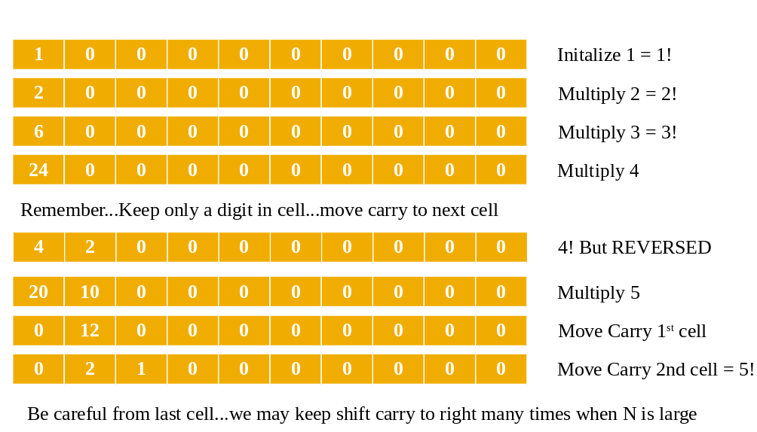
Big Integers: Factorial

Slide 11
Rounding Values
Rounding is replacing value with another approximate value...many types and styles
In C++, we have 4 rounding functions
round: nearest integer to x [halfway cases away from 0]
floor: round down
ceil: round up
trunc: rounds toward zero (remove fraction)
In integers, x/y is floor of results
ceil(x, y) = (x+y-1)/y
round(x, y) = (x+y/2)/y [if x > 0] and (x-y/2)/y [x < 0]

Slide 12
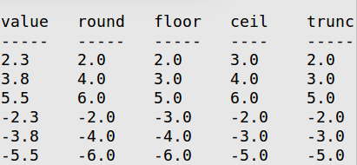
Rounding Values: Examples
Be careful from -ve and 0.5
round(x) == x < 0 ? ceil(x-0.5) : floor(x+0.5);
To round to multiple of a specified amount
round(x, m) = round(x / m) * m
round(48.2 seconds, 15) = 45 seconds
round(2.1784 dollars, 0.01 (1 cent) ) = 2.18 dollars

Slide 13
Exponential function
If we have 2 jackets, 2 jeans & 2 shoes, I can have 2x2x2 = 2³ = 8 different clothing styles
Exponential function: y = b^{x}
b (base), x (exponent): real,integer,+ve,-ve
Popular values: 2, 10, e [e is Euler's number ~= 2.7]
a 64 bit integer stores 2⁶⁴ numbers … a very big number
2^{-x} = (½)^{x} = 0.5^{x} and 2^{x} = (½)^{-x} = 0.5^{-x}
In C++: pow(2, 3) = 2³ = 8
Exponential indicates growing fast

Slide 14
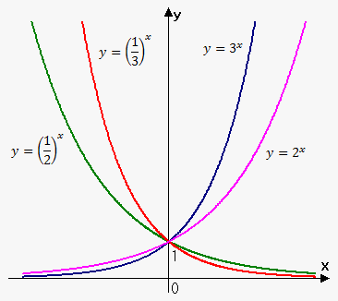
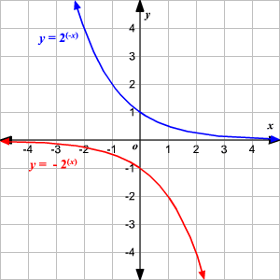
Exponential function: Graphs
Notes:
http://www.emathhelp.net/images/calc/1_2_exponential_function.png
http://hotmath.com/hotmath_help/topics/graphing-exponential-and-logarithmic-functions/graph3.gif

Slide 15
Logarithm
It is the inverse operation to exponentiation
y = b^{x} ==> log_{b}y = x
log₁₀1000 = how many 10 multiplications = 1000? 3
log₂16 = how many 2 multiplications = 16? 4
log₁₀0.001 = how many 10 divisions = 1/1000? -3
b=[10, e, 2] => (common, natural, binary) log
Math notations: lg(x), ln(x), lb(x)
In c++: log10(x), log(x), log2(x)
log is strictly increasing for b > 1
log is strictly decreasing for 0 < b < 1

Slide 16
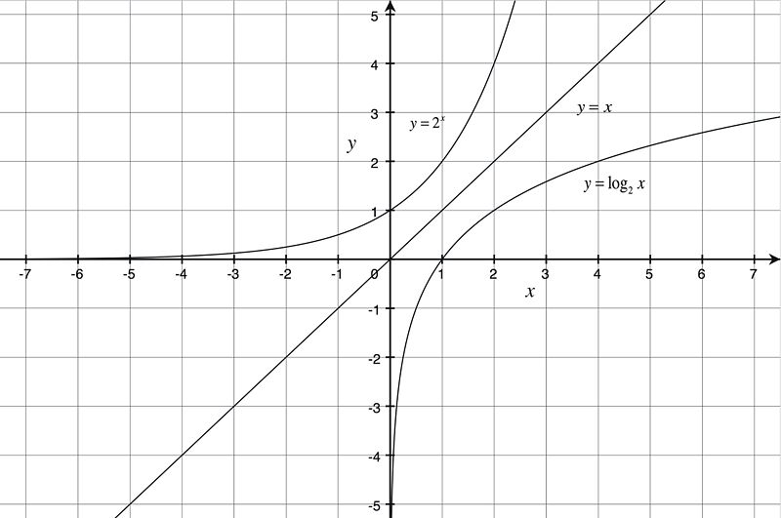
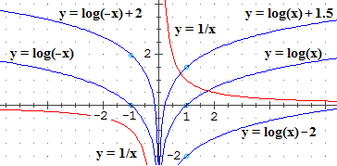
Logarithm: Graphs
log is strictly increasing function. Strictly [nothing equal], increasing, go up.
1 2 5 5 7 9 [Increasing]
1 2 5 6 7 9 [strictly Increasing]
9 7 5 5 2 1[decreasing]
9 7 6 5 2 1 [strictly decreasing]
Notes:
https://dr282zn36sxxg.cloudfront.net/datastreams/f-d%3Ad344e606b72a57160dee2afdd494668ac584cb32ec28ddd3fe5d567c%2BIMAGE%2BIMAGE.1
http://macosa.dima.unige.it/om/voci/integra/log.gif

Slide 17
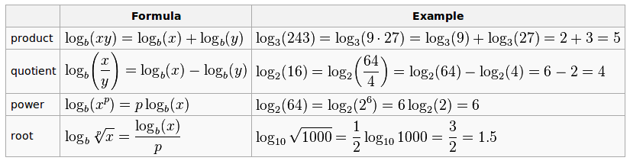


Logarithm Operations
log_{b}b = 1, log_{b}1 = 0, log_{b}0 = -oo, log₁x = undefined
b^{logb(x)} = x => take log_{b} for the equation to get x
xb^{y} => b^{logb(x) + y}

Slide 18
Logarithm and # of digits
base 10 can be used to know # of digits
# digits = 1 + floor(log₁₀(x))
log10(1000) = 3 => 4 digits
log10(1430) = 3.15 => 4 digits
log10(9999) = 3.99 => 4 digits
log10(10000) = 4 => 4 digits
So from 1000 to 10000-1, we have log10(x) = 3.xyz..
Generally, # of digits in base b.
log2(16) = 4 => 5 bits. [16 in base 10 = 10000 in base 2]
Homework: # of digits of factorial n?

Slide 19
Math Materials
Knowledge of interest here
Mathematics part in
Programming Challenge
Competitive Programming
Algorithms Books (e.g. CLR)
Other Math Books
Concrete Mathematics
Discrete Mathematics and Its Applications
Mathematics for Computer Science (2013)
Solving...Solving...Solving
if can’t solve..see editorial/solution...take notes

Slide 20
Time To Solve
There are some ad-hoc problems in the video
There also some problems on Big Integers
This type of problems usually don’t appear nowadays
Why?: problem setters avoid languages advantages
Warmup by solving some of them :)
Also read this cheat sheet

Slide 21
تم بحمد الله
علمكم الله ما ينفعكم
ونفعكم بما تعلمتم
وزادكم علماً

